Slide 1
智能系统及应用综合课程设计
Mofei Song
PAttern Learning and Mining(PALM) Lab
Southeast University

Slide 2
实践课课程安排
两个大实验，分组完成，2人一组
主流方法概述（2课时）
实践（24课时）
自行调研和确定方案
采用给定数据集进行训练
对测试数据集进行预测
根据预测准确率排序
分组报告（6课时，每组6分钟左右）
Notes:
如果用mindspore+ascend 910训练卡

Slide 3
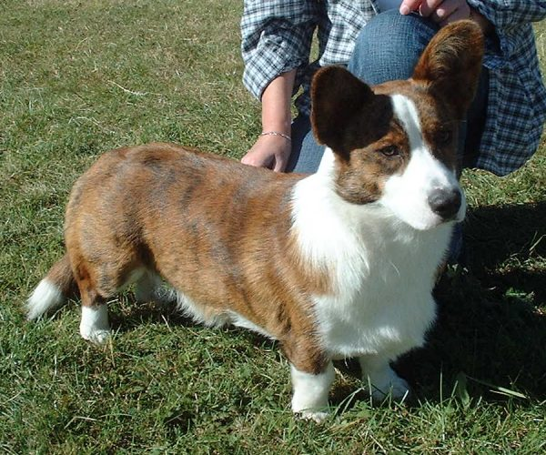
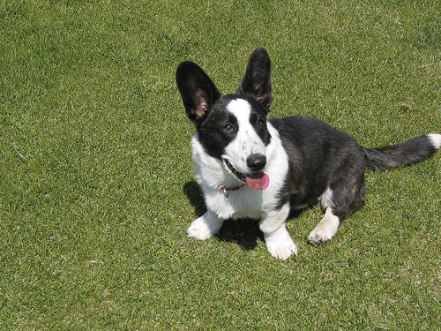
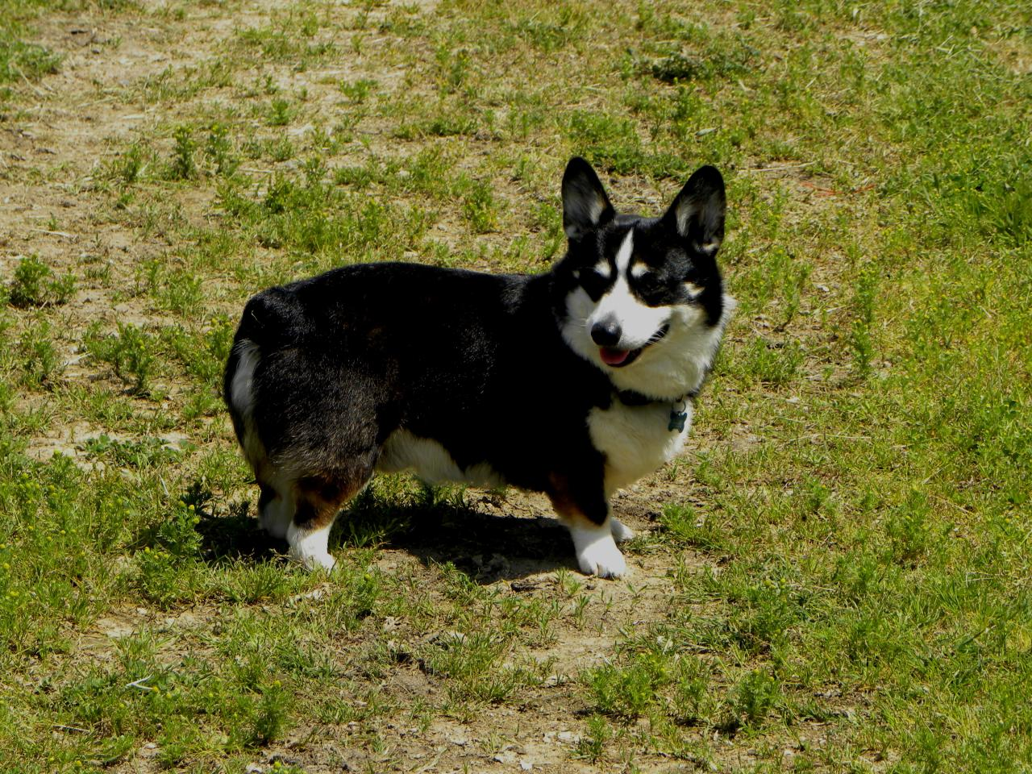
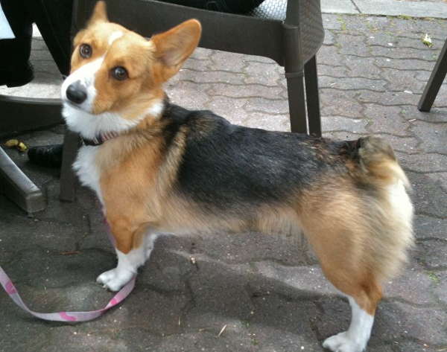
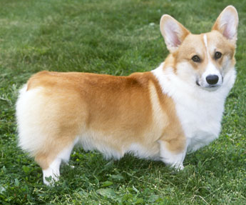
Fine-Grained Recognition
…
Cardigan Welsh Corgi
?
…
What breed is this dog?
Pembroke Welsh Corgi
Key: Find the right features.
Notes:
Now, what’s the key to fine-grained recognition? Let’s look at this dog, what breed is it? It turns out that it looks like these two, cardigan welsh corgi and pembroke welsh corgi. Which one is it? In fact, to make the right classification, we need to look at the tails. One breed has a longer tail than the other. So the key is finding the right features.

Slide 4
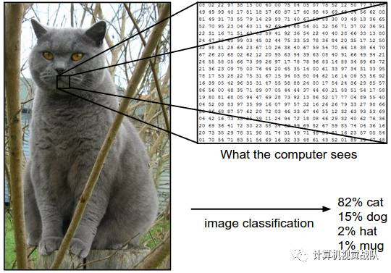
背景
基于深度学习的图像分类

Slide 5
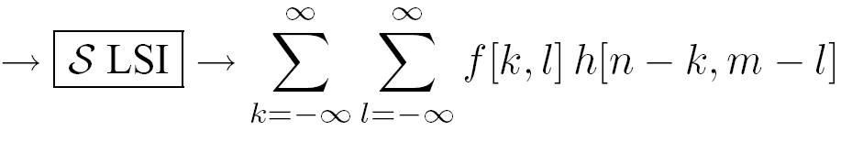
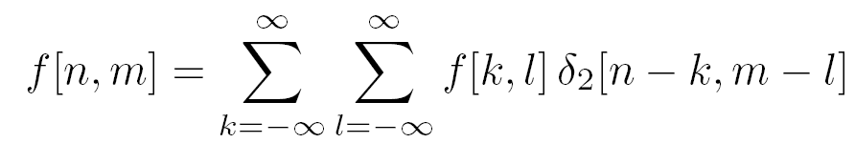
Recall convolutions…
12 | 3 | 19
25 | 10 | 1
9 | 7 | 17
1 | 2
3 | 4
? | ?
? | ?
*
=

Slide 6
Recall convolutions…
12 | 3 | 19
25 | 10 | 1
9 | 7 | 17
1 | 2
3 | 4
133 | ?
? | ?
*
=

Slide 7
Recall convolutions…
12 | 3 | 19
25 | 10 | 1
9 | 7 | 17
1 | 2
3 | 4
133 | 75
? | ?
*
=

Slide 8
Recall convolutions…
12 | 3 | 19
25 | 10 | 1
9 | 7 | 17
1 | 2
3 | 4
133 | 75
100 | ?
*
=

Slide 9
Recall convolutions…
12 | 3 | 19
25 | 10 | 1
9 | 7 | 17
1 | 2
3 | 4
133 | 75
100 | 101
*
=
Notes:
Equation

Slide 10
Recall convolutions…
12 | 3 | 19
25 | 10 | 1
9 | 7 | 17
1 | 2
3 | 4
133 | 75
100 | 101
*
=
Notes:
Equation

Slide 11
Recall convolutions…
12 | 21
18 | 31
1 | 2
3 | 4
?
*
=
Notes:
Equation

Slide 12
Recall convolutions…
12 | 21
18 | 31
1 | 2
3 | 4
232
*
=
Notes:
Equation

Slide 13
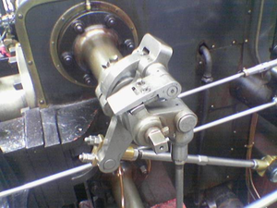
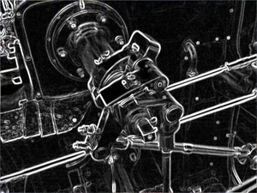
Why they are useful
Allow us to find interesting insights/features from images!
0 | -½ | 0
0 | 0 | 0
0 | ½ | 0
*
=

Slide 14
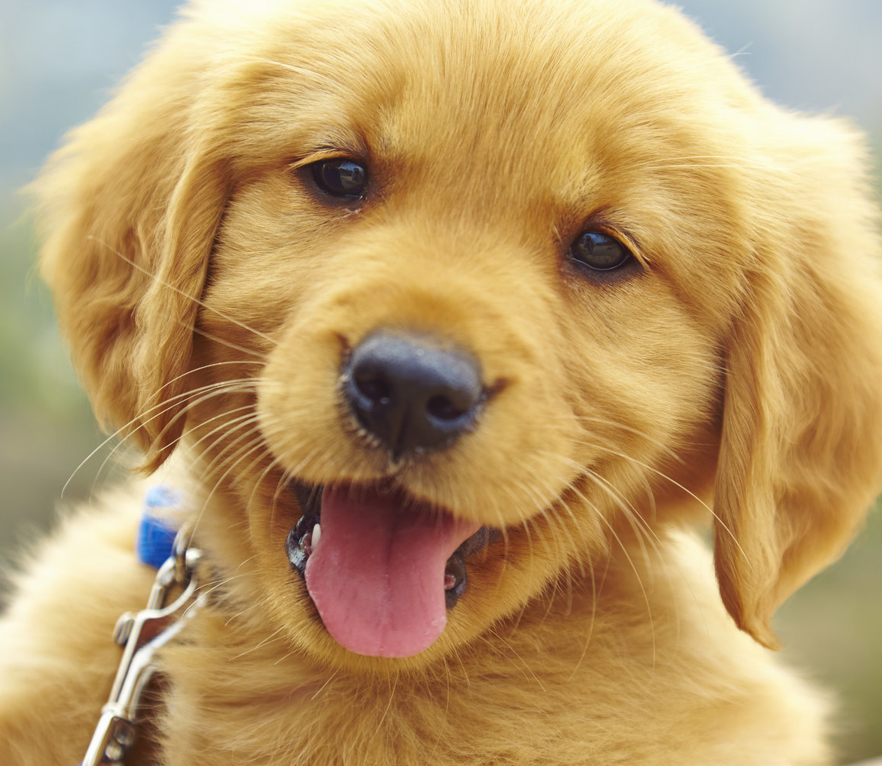
Recall Image Classification…
Featurizer
Classifier
“pupper”
Allow us to use features to put images in categories!

Slide 15

Wait a Minute…
Convolution = Image -> Features
Classification Algorithm = Features -> Category

Slide 16

Wait a Minute…
Convolution = Image -> Features
Classification Algorithm = Features -> Category
Let’s put ‘em together!

Slide 17
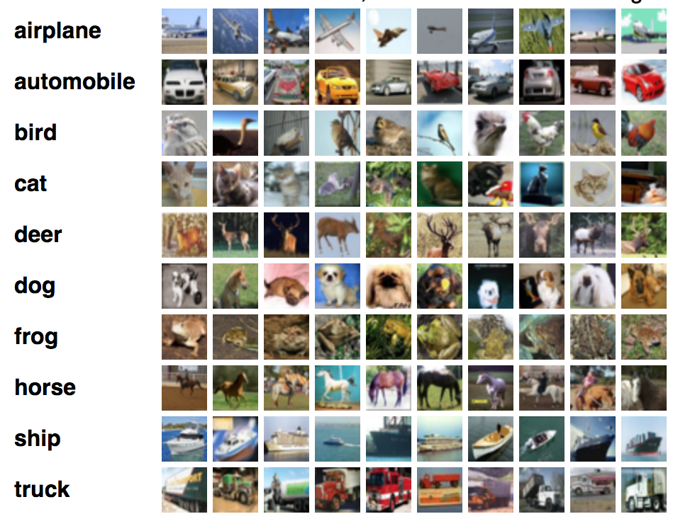
In Specific…
Let’s build a convolution-based classification algorithm for the
CIFAR-10 dataset (10 classes, 32x32 images):

Slide 18
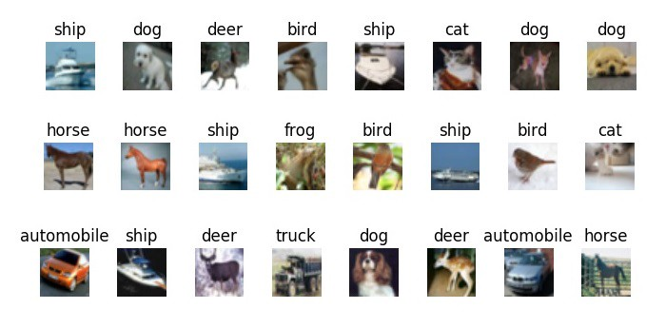
Feature Extractor
32x32 “Airplane Filter”
*
=

Slide 19
Feature Extractor
“probability” of the image being an airplane
32x32 “Airplane Filter”
*
=

Slide 20
Feature Extractor
“probability” of the image being an airplane
32x32 “Airplane Filter”
*
=

Slide 21
Feature Extractor
This is not really a probability but a score, because it can be less than 0 and greater than 1
“probability” of the image being an airplane
32x32 “Airplane Filter”
*
=

Slide 22
Feature Extractor
“probability” of the image being an automobile
32x32 “Automobile Filter”
*
=

Slide 23
Feature Extractor
“probability” of the image being a bird
32x32 “Bird Filter”
*
=

Slide 24
Feature Extractor
“probability” of the image being a truck
32x32 “Truck Filter”
*
=

Slide 25
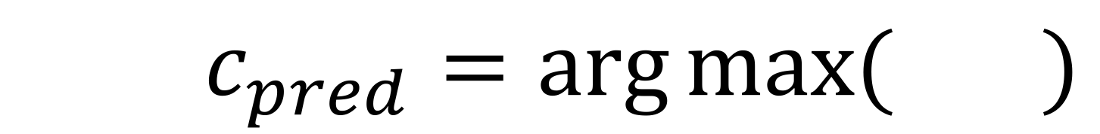
Classifier
$c_{pred}=\arg{\max{(} )}$

Slide 26
Classifier
$c_{pred}=\arg{\max{(} )}$
We predict the class that has the highest probability!

Slide 27
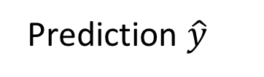
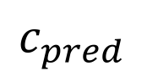
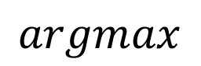
The Whole Shebang
32x32x10 Conv Block
$$argmax$$
$$c_{pred}$$
Feature Extractor
Prediction $\hat{y}$
Classification Output
Image
Classifier

Slide 28
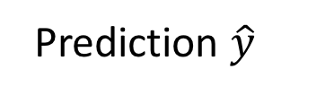
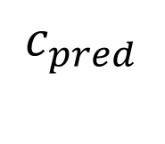
The Whole Shebang
32x32x10 Conv Block
$$argmax$$
$$c_{pred}$$
Feature Extractor
Prediction $\hat{y}$
Classification Output
Image
Classifier

Slide 29
Reframing convolution
12 | 21
18 | 31
1 | 2
3 | 4
*
Notes:
Equation

Slide 30
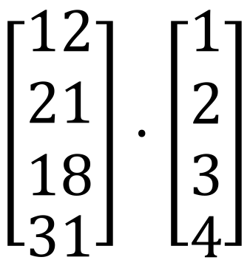
Reframing convolution
12 | 21
18 | 31
1 | 2
3 | 4
$$\left[\begin{matrix}\begin{aligned}12 \\ 21 \\ 18\end{aligned} \\ 31\end{matrix}\right]⋅\left[\begin{matrix}\begin{aligned}1 \\ 2 \\ 3\end{aligned} \\ 4\end{matrix}\right]$$
*
=
Notes:
Equation

Slide 31
Reframed Feature Extractor
32x32 “Airplane Filter”
*

Slide 32
Reframed Feature Extractor
Image
Vector
Airplane Weight Vector
32x32 “Airplane Filter”
.
*
=

Slide 33
New Feature Extractor
Image
Vector
Airplane Weight Vector
“probability” of the image being an airplane
.
=

Slide 34
New Feature Extractor
Image
Vector
Automobile Weight Vector
“probability” of the image being an automobile
.
=

Slide 35
New Feature Extractor
Image
Vector
Bird Weight Vector
“probability” of the image being a bird
.
=

Slide 36
New Feature Extractor
Image
Vector
Truck Weight Vector
“probability” of the image being a truck
.
=

Slide 37
New Feature Extractor
Weight Matrix
Image
Vector
X
=

Slide 38
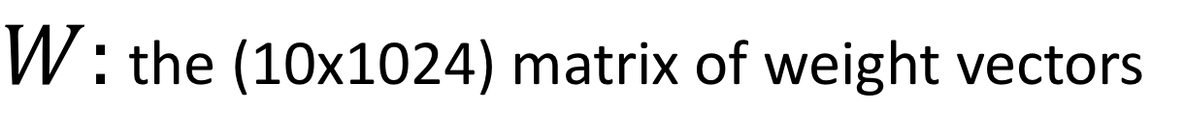
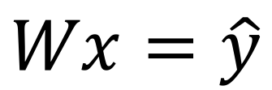
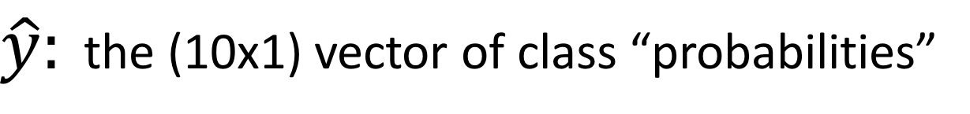
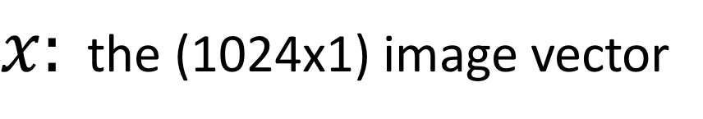
New Feature Extractor
$$Wx=\hat{y}$$
$W:$ the (10x1024) matrix of weight vectors
$x:$ the (1024x1) image vector
$\hat{y}:$ the (10x1) vector of class “probabilities”

Slide 39
New Feature Extractor
This simple computation is called a fully-connected layer!
$$Wx=\hat{y}$$
$W:$ the (10x1024) matrix of weight vectors
$x:$ the (1024x1) image vector
$\hat{y}:$ the (10x1) vector of class “probabilities”

Slide 40
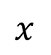
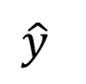
Aside: Fully-Connected Neural Networks
Height
Dog
Algorithm
Width
Not Dog
Num_Legs
$$x$$
$$\hat{y}$$

Slide 41
Aside: Fully-Connected Neural Networks
Height
Dog
Width
Not Dog
Num_Legs
$$x$$
$$\hat{y}$$

Slide 42
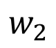
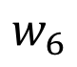
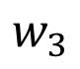
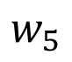
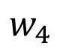
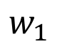
Aside: Fully-Connected Neural Networks
Height
$$w_{1}$$
$$w_{4}$$
Dog
$$w_{2}$$
Width
$$w_{5}$$
$$w_{3}$$
Not Dog
$$w_{6}$$
Num_Legs
$$x$$
$$\hat{y}$$

Slide 43

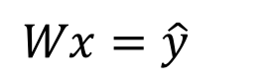
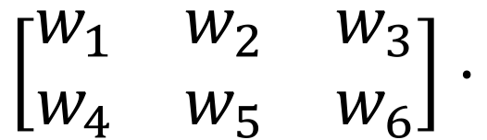
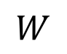
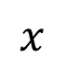
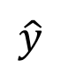
Aside: Fully-Connected Neural Networks
$$\left[\begin{matrix}w_{1} & w_{2} & w_{3} \\ w_{4} & w_{5} & w_{6}\end{matrix}\right]⋅$$
$$=$$
$$W$$
$$x$$
$$\hat{y}$$
$$Wx=\hat{y}$$

Slide 44
Aside: Fully-Connected Neural Networks
”Fully-Connected”
”Neural Network”
Every node is connected to every other node
Kinda looks like a neuron!

Slide 45
New Feature Extractor
$$Wx=\hat{y}$$
$W:$ the (10x1024) matrix of weight vectors
$x:$ the (1024x1) image vector
$\hat{y}:$ the (10x1) vector of class “probabilities”

Slide 46
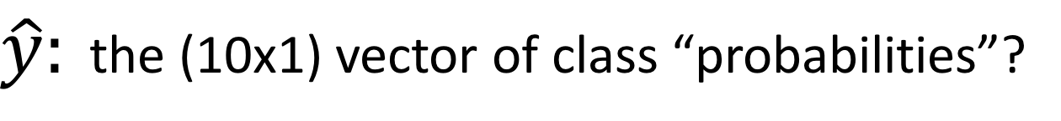
New Feature Extractor
$$Wx=\hat{y}$$
$W:$ the (10x1024) matrix of weight vectors
$x:$ the (1024x1) image vector
$\hat{y}:$ the (10x1) vector of class “probabilities”?

Slide 47
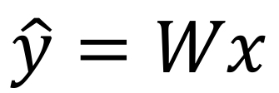
Class Probability Vector
Must have values between 0 and 1
Must sum to 1
There’s no guarantee either requirement is satisfied!
$$\hat{y}=Wx$$

Slide 48
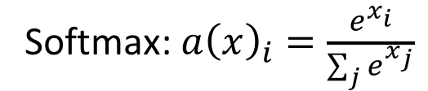
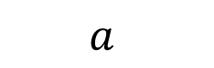
Softmax Function
$$a$$
1
-3
Softmax: $a{\left(x\right)}_{i}=\frac{e^{x_{i}}}{\sum_{j}{e^{x_{j}}}}$

Slide 49
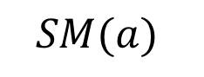
Softmax Function
$$a$$
$$SM(a)$$
0.98
1
0.02
-3
Softmax: $a{\left(x\right)}_{i}=\frac{e^{x_{i}}}{\sum_{j}{e^{x_{j}}}}$

Slide 50
Class Probability Vector
Must have values between 0 and 1
Must sum to 1
$$\hat{y}=Wx$$

Slide 51
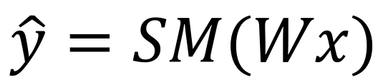
Class Probability Vector
Must have values between 0 and 1
Must sum to 1
$$\hat{y}=SM(Wx)$$

Slide 52
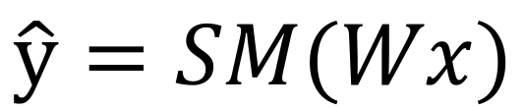
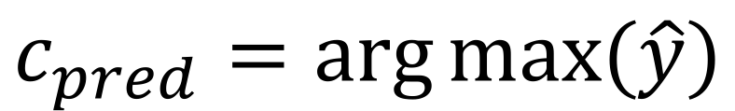
System so far…
Feature extractor:
Classifier:
$$\hat{y}=SM(Wx)$$
$$c_{pred}=\arg{\max{(\hat{y})}}$$

Slide 53
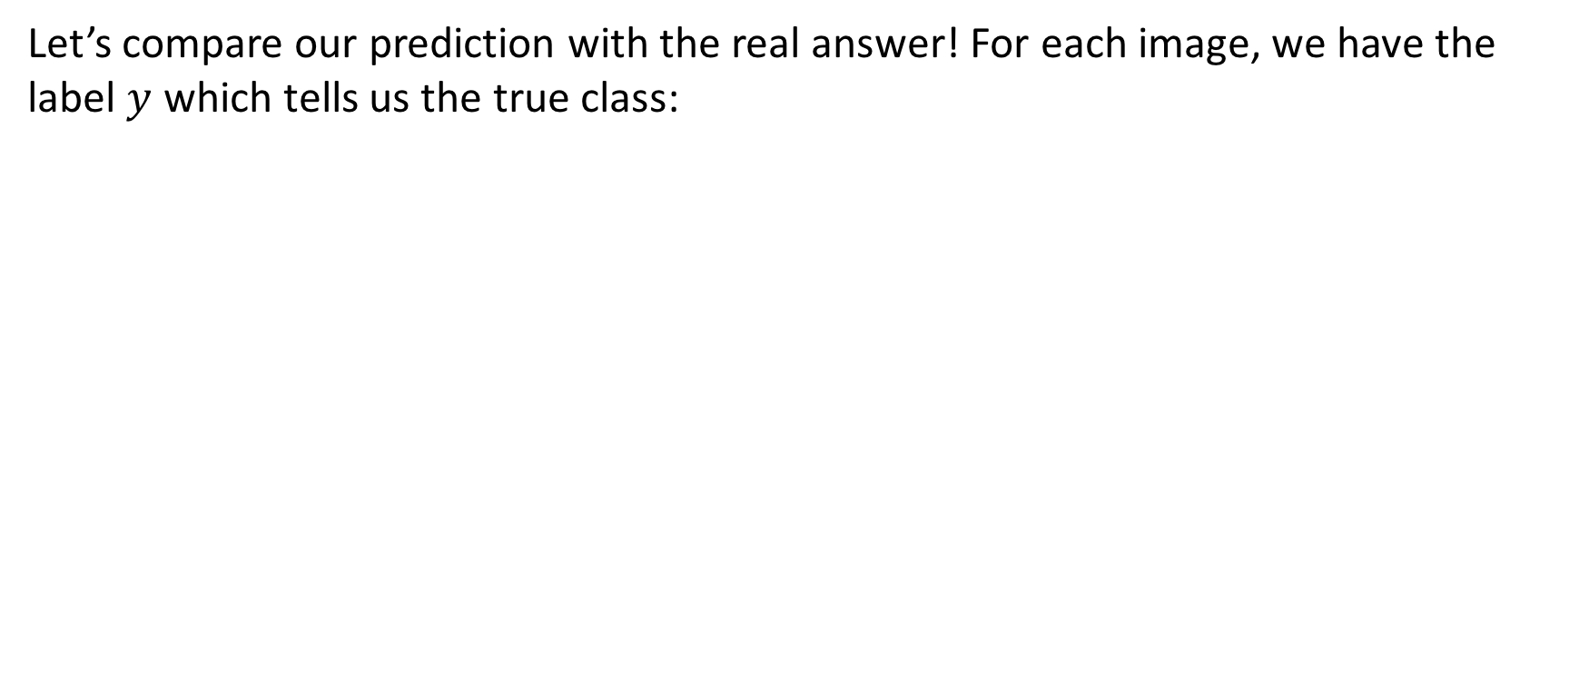
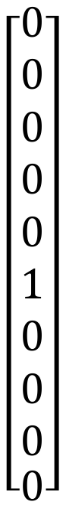
Using the label
Let’s compare our prediction with the real answer! For each image, we have the label $y$ which tells us the true class:
y
X
$$\left[\begin{matrix}\begin{aligned}0 \\ 0 \\ 0 \\ 0 \\ 0 \\ 1 \\ 0 \\ 0 \\ 0\end{aligned} \\ 0\end{matrix}\right]$$
Dog class index

Slide 54
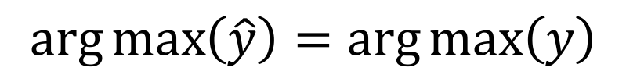
Key Insight:
We want:
$$\arg{\max\left(\hat{y}\right)}=\arg{\max\left(y\right)}$$

Slide 55
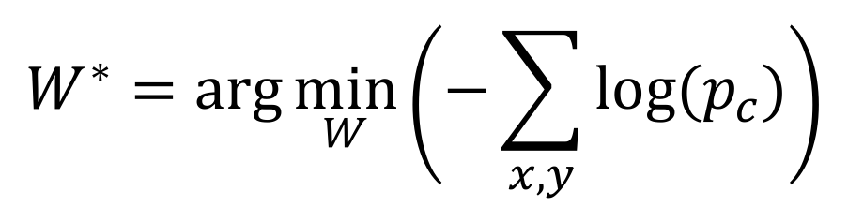
Key Insight:
We want:
$$\arg{\max\left(\hat{y}\right)}=\arg{\max\left(y\right)}$$
Which we can accomplish by:
$$W^{∗}=\arg{\min_{W}\left(−\sum_{x,y}{log⁡(p_{c})}\right)}$$

Slide 56
Our Classification System
32x32x10 Conv Block
$$argmax$$
$$c_{pred}$$
Feature Extractor
Prediction $\hat{y}$
Classification Output
Image
Classifier

Slide 57
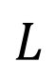





Our Classification System (modified)
32x32x10 Conv Block
$$argmax$$
$$c_{pred}$$
Feature Extractor
Prediction $\hat{y}$
Classification Output
Input Image
Classifier
$$y$$
$$CE$$
$$L$$
Input Label
Loss Function
Loss Value

Slide 58
Our Classification System (modified)
32x32x10 Conv Block
$$argmax$$
$$c_{pred}$$
Feature Extractor
Prediction $\hat{y}$
Classification Output
Input Image
Classifier
1) Minimize this…
$$y$$
$$CE$$
$$L$$
Input Label
Loss Function
Loss Value

Slide 59
Our Classification System (modified)
32x32x10 Conv Block
$$argmax$$
$$c_{pred}$$
Feature Extractor
Prediction $\hat{y}$
Classification Output
Input Image
Classifier
2) By modifying this…
1) Minimize this…
$$y$$
$$CE$$
$$L$$
Input Label
Loss Function
Loss Value

Slide 60
Our Classification System (modified)
32x32x10 Conv Block
$$argmax$$
$$c_{pred}$$
Feature Extractor
Prediction $\hat{y}$
Classification Output
Input Image
Classifier
2) By modifying this…
1) Minimize this…
$$y$$
$$CE$$
$$L$$
Input Label
Loss Function
Loss Value
3) Using gradient descent!

Slide 61

Visualizing the Filters

Slide 62
Convolutions
Convolutions = Insights
More Convolutions = More Insights?

Slide 63


Recall Hubel and Weisel…

Slide 64
Recall Hubel and Weisel…
The edges can be grouped into triangles and ovals…
It’s a mouse toy!
The thing has edges…
The triangles are ears, the oval is a body…
Notes:
Hierarchical approach to how it sees things

Slide 65

Recall Hubel and Weisel…
The edges can be grouped into triangles and ovals…
It’s a mouse toy!
The thing has edges…
The triangles are ears, the oval is a body…
Notes:
Make a computer to do the same thing? Notice that we know we can make Sobel filter (i.e. very simple filter) to do low-level tasks

Slide 66



Convolutions Across Channels
$28×28×3$ Image
$15×15×3$ Filter
$14×14×1$ Output

Slide 67


Convolutions Across Channels
$28×28×3$ Image
$15×15×3×4$ Filter
$14×14×4$ Output
Notes:
Why would we want this?

Slide 68
Convolutions Across Channels
more output channels
= more filters
= more features we can learn!
$28×28×3$ Image
$15×15×3×4$ Filter
$14×14×4$ Output

Slide 69

Convolutions Across Channels
$15×15×3×4$ Conv Block
Notes:
For simplicity

Slide 70









Stacking Convolutions
$$15×15×4×6$$
Conv Block
$$8×8×6×8$$
Conv Block
$$7×7×8×10$$
Conv Block
$5×5×3×4$ Conv Block
$32×32×3$ Input
$$28×28×4$$
Output
$$14×14×6$$
Output
$$7×7×8$$
Output
$$1×1×10$$
Output
Notes:
Input turns into smaller spatial dimensions, channels increase in size to give more “features” to learn
First few layers give edges, then shapes, then concepts, then classification

Slide 71
Stacking Convolutions
$$15×15×4×6$$
Conv Block
$$8×8×6×8$$
Conv Block
$$7×7×8×10$$
Conv Block
$5×5×3×4$ Conv Block
CONVOLUTIONAL NEURAL NETWORK!
$32×32×3$ Input
$$28×28×4$$
Output
$$14×14×6$$
Output
$$7×7×8$$
Output
$$1×1×10$$
Output
Notes:
Input turns into smaller spatial dimensions, channels increase in size to give more “features” to learn
First few layers give edges, then shapes, then concepts, then classification

Slide 72


AlexNet – 2012
Notes:
ImageNet (1000 fine-grained classes)
16.4% top5% test error rate (down from 26% test error rate) on
Year when people started taking notice

Slide 73

Introduction
Introducing granularity
Subordinate categories
Parts & Attributes
Long-tailed distributions
Popular datasets
Beyond categorization
Open problems

Slide 74

















Introduction
Fine-grained image recognition vs. Generic image recognition
Meta class
Dog
Bird
…
Dog
…
Orange
Husky
…
Satsuma
…
Alaska
Traditional image recognition (Coarse-grained)
Fine-grained image recognition
Notes:
细粒度图像分析（FGIA）专注于处理属于同一大类不同子类的问题（例如，鸟、狗与车辆），通常包括主要任务例如细粒度图像识别，细粒度图像检索，细粒度图像生成等。
将FGIA与其它通用方法进行区分的是：通用图像分析中，目标属于粗粒度的大类（例如，鸟、橙子与狗），因此，视觉差距很大。然而，在FGIA中，目标来自一个大类别的不同子类，细粒度特性导致他们的视觉相似性。我们将图像识别作为例子。如图1所示，在细粒度识别中，任务要求识别狗这个类别中的相似子类别，例如，哈士奇、萨摩耶与阿拉斯加。为了进行精确的识别，需要通过捕捉细微的与精细的特征来区分他们（例如耳朵、鼻子、尾巴），这也与其它FGIA任务要求相同（例如检索与生成）。
此外，细粒度的特性还由于高度相似的子类的小类间差与姿势、尺度与旋转带来的大类内差距，如图3所示。这与通用图像分类不同（例如，小类内差与大类间差），这使得细粒度图像分类称为具有挑战性的问题。

Slide 75



Introduction
Various real-world applications
https://www.kaggle.com/c/the-nature-conservancy-fisheries-monitoring
Notes:
真实世界中，FGIA无论是在工业界还是学术界都有广泛的应用，比如鱼类类别识别。
海洋蕴藏着极其丰富的生物资源和非生物资源，这些资源不仅是建设“蓝色粮仓”
的重要物质基础，也是维持全球生态平衡举足轻重的存在。海洋资源中重要的一项就是渔业资源，科学开发和保护渔业资源，
促进可持续渔业管理战略发展，将有利于我国海洋强国战略目标的实现。
现代渔业发展关系到很多新设施、新技术、新机制的应用开发，渔业监测是其中
非常重要的部分。精确的渔业数据能够为渔业管理提供决策依据，方便科学设定总捕
捞量、实现渔业的可持续管理、促进渔业转型和改进。为保证鱼类健康生长，从鱼苗
育种期间就需要对鱼种进行快速识别并采集各阶段的鱼种数量、重量、体长等各项指
标。这些数据同时反映了水下环境参数的变化，能够更好地辅助鱼类养殖、捕捞和鱼
道建设等，因此有必要对鱼类进行实时检测识别。
随着数字成像技术的成熟与相关设备的普及。水下拍摄在渔业方面的应用日益广
泛。智能监测利用计算机视觉技术，在不需要人工干预的情况下，可对自然条件下拍
摄的水下视频图像场景中存在的鱼体目标进行自动检测及识别。这极大地提高了工作
效率及准确度，对于指导渔业可持续发展、保护生态平衡有着重要的意义[2]。

Slide 76


Introduction
Various real-world applications
https://www.kaggle.com/c/humpback-whale-identification
Notes:
为了帮助鲸鱼保护，科学家们使用照片监视系统来监视海洋活动。他们使用鲸鱼尾巴这一独一无二的标记来在连续的图像中识别鲸鱼，并对它们的活动进行细致地分析。全球共2131个团队参加了比赛。

Slide 77













Introduction
Various real-world applications
https://www.kaggle.com/c/inaturalist-challenge-at-fgvc-2017
Notes:
It’s estimated that our planet contains several million species of plants and animals–many that look really similar to each other. Because of this, a lot of species in the natural world are too hard to classify without an expert.
As part of the FGVC4 workshop at CVPR 2017 we are conducting the iNat Challenge 2017 large scale species classification competition, sponsored by Google. It is estimated that the natural world contains several million species of plants and animals. Without expert knowledge, many of these species are extremely difficult to accurately classify due to their visual similarity. The goal of this competition is to push the state of the art in automatic image classification for real world data that features fine-grained categories, big class imbalances, and large numbers of classes.
The iNat Challenge 2017 dataset contains 5,089 species, with a combined training and validation set of 675,000 images that have been collected and verified by multiple users from inaturalist.org. The dataset features many visually similar species, captured in a wide variety of situations, from all over the world.
49teams 0.99911

Slide 78




Introduction
Various real-world applications
Identify plant species from herbarium specimens.
https://www.kaggle.com/c/herbarium-2020-fgvc7/
Notes:
The Herbarium 2020 FGVC7 Challenge is to identify vascular plant species from a large, long-tailed collection herbarium specimens provided by the New York Botanical Garden (NYBG).
The Herbarium 2020 dataset contains over 1M images representing over 32,000 plant species. This is a dataset with a long tail; there are a minimum of 3 specimens per species. However, some species are represented by more than a hundred specimens. This dataset only contains vascular land plants which includes lycophytes, ferns, gymnosperms, and flowering plants. The extinct forms of lycophytes are the major component of coal deposits, ferns are indicators of ecosystem health, gymnosperms provide major habitats for animals, and flowering plants provide all of our crops, vegetables, and fruits.
The New York Botanical Garden (NYBG) herbarium contains more than 7.8 million plant and fungal specimens. Herbaria are a massive repository of plant diversity data. These collections not only represent a vast amount of plant diversity, but since herbarium collections include specimens dating back hundreds of years, they provide snapshots of plant diversity through time. The integrity of the plant is maintained in herbaria as a pressed, dried specimen; a specimen collected nearly two hundred years ago by Darwin looks much the same as one collected a month ago by an NYBG botanist. All specimens not only maintain their morphological features but also include collection dates and locations, and the name of the person who collected the specimen. This information, multiplied by millions of plant collections, provides the framework for understanding plant diversity on a massive scale and learning how it has changed over time.
This is an FGVC competition hosted as part of the FGVC7 workshop at CVPR 2020 and sponsored by NYBG.
153 teams 0.84484

Slide 79

Introduction
Various real-world applications
Notes:
基于视觉的车辆细粒度分类技术是智能交通中的关键技术，不仅能够有效辅助解决车辆盗窃、违章车 辆判别等社会问题，同时对目前大数据应用趋势下的商 业系统也有着重要的意义。近年来，深度学习尤其是深 度卷积神经网络在计算机视觉上的成功，引发了人们浓 厚的研究兴趣。深度卷积特征的加入，为车辆细分类的 发展带来了新的机遇。
由于交通路口斜视角度在视野上的局限性，在高 空场景下对车辆进行识别细分类更加有实际应用价值， 一方面能更好地检测识别出违章车辆;另一方面，还可 以对目标车辆进行重识别和持续跟踪。
智能交通系统是综合利用地面交通的传感、分析、控制和通信技术来发展
和提高交通系统的机动性、效率、和安全性的系统。智能交通系统有着广泛的应
用，包括收集、传输和处理数据，以缓解交通拥堵，提高交通管理效率，加
快应对突发交通事故的反应速度等。
视频监控负担着交通网络规划和控制的巨大任务，是智能交通的重要组成
部分，有着巨大的研宄潜力。随着经济的快速发展，我国机动车数量己经突破２
亿且依然保持着増长趋势。在这种背景下，研宄探索先进的智能交通算法变的愈
加重要和迫切。在过去的十几年中，因为监控摄像头成本的不断降低，使得大量
的交通数据以图片或视频的形式被记录下来，由此产生了许多基于计算机视觉
的分析视频监控的方法。
在交通系统中，车辆计数车牌识别、事故检测等特定的监控任务
可以通过基于传感器的算法来实现。然而，这种方法有很多的限制，以车辆检测
为例，基于传感器的技术只能检测较小区域内的车辆。相比之下，基于视觉的方
法可以充分利用图像或视频中的信息，以类人的方式识别目标对象。通过摄像机
等设备，这类方法能在大的可视区域内检测到所有车辆，同时给出每个被检测车
辆的颜色、车型等特征信息。因此，本文提出并研究了几种计算机视觉和深度学
习的模型，来解决基于传感器算法中检测区域小、设备部署复杂等问题。

Slide 80




Introduction
Various real-world applications
https://rpc-dataset.github.io/
Notes:
新零售 无人店

Slide 81


Introduction
Various real-world applications

Slide 82

The Categorization Spectrum
Basic
Subordinate
Biometrics
[R. Farrell]

Slide 83

[R. Farrell]
Notes:
蜘蛛的眼睛

Slide 84

[R. Farrell]

Slide 85


Slide 86



Long-tailed fine-grained datasets
https://www.kaggle.com/c/inaturalist-challenge-at-fgvc-2017
Notes:
现实世界中,大规模图像数据集通常呈现长尾分布现象,少数类别含有大量的样本,大多数类别仅有极少量样本。传统的视觉识别方法应用到长尾分布的图像数据集时,会出现模型失效、识别准确率骤降等问题。
长尾分布现象广泛存在互联网行业中，大多数用户的需求集中在头
部，例如流行一时的热门商品或者音乐视频等，而尾部零散小量的需求会形成一条长长
的尾巴。长尾分布数据集的学习实际上是不平衡分类问题和小样本学习问题的综合体
对于长尾数据头部类别的识别可以视为不平衡分类问题，尾部分类别由于样本数量
太少可视为小样本学习问题。相比于传统平衡数据集的学习，长尾分布识别问题通常会
遇见不平衡学习以及少样本学习问题的挑战，如：
（1）由于头部类占据了整个数据集的大部分样本，模型在学习过程中，训练损失
将会被头部类别所主导，模型可以很好地学习头部类别的特征，却学习不到尾部类别的
特征。
（2）由于尾部类仅有极个别样本，它难以表达类别内部的变化，比如同一类别不
同角度、不同光线下的样本。因此模型学习的决策边界往往靠近这些尾部类样本，导致
属于同一类别但特征差异较大的样本容易被错误识别。
在识别长尾分布数据时，许多标准高效的卷积神经网络模型将无法正确建模，模型在头
部类上表现良好，在尾部类上几乎无法识别目标，导致整体的识别精确度显著下降。近
年来，针对现有标准方法无法学习长尾分布数据集的现象，计算机视觉领域出现了许多
研究长尾分布识别的工作，即在每一类中的样本数量变化很大且遵循长尾分布的数据中
进行建模学习。

Slide 87


















Challenge of fine-grained visual analysis
Intra-class variances
Artic Tern
Small inter-class variance
Large intra-class variance
Common Tern
Forster’s Tern
Caspian Tern
Inter-class variances

Slide 88

The key of fine-grained visual analysis

Slide 89

CUB-200 Dataset

Slide 90

Fine-grained benchmark datasets
CUB200-2011
11,788 images, 200 fine-grained classes
[Catherine Wah et al., CNS-TR-2011-001, 2011]

Slide 91

Fine-grained benchmark datasets
Oxford Flowers
8,189 images, 102 fine-grained classes
[Maria-Elena Nilsback and Andrew Zisserman, CVGIP 2008]

Slide 92

Fine-grained benchmark datasets
Stanford Cars
16,185 images, 196 fine-grained classes
[Jonathan Krause et al., ICCV Workshop 2013]

Slide 93


Fine-grained benchmark datasets
Aircrafts
10,200 images
100 fine-grained classes
[S. Maji et al., arXiv: 1306.5151, 2013]

Slide 94








Slide 95
Fine-grained image recognition
A taxonomy of fine-grained recognition
Recognition by “localization-classification subnetworks”
Employing detection or segmentation methods
Utilizing deep filters
Leveraging attention mechanisms
Other representative methods
Recognition by “end-to-end feature encoding”
Performing high-order feature interactions
Designing specific loss functions
Other methods
Recognition with “external information”
Recognition with web data
Recognition by using multi-modality data
Recognition with humans-in-the-loop
Notes:
细粒度识别的方法可以分为3个主要的类型，例如，细粒度识别（1）具有定位分类子网络；（2）端到端编码；（3）具有额外的信息。这些方法中，第一与第二个将它们局限利用细粒度图片的监督信息，例如图像标签、bbox部件标注等。此外，自动识别系统由于细粒度挑战不能取得完美的表现。因此，研究者最终尝试引入额外但容易获得的信息（例如，网络数据，文字描述）到犀利如识别任务中，从而进一步改进准去了，这对应细粒度识别的第三个方面。细粒度识别流行的评估方法是通过计算数据集所有子类别平均分类准确率得到。

Slide 96







Localization-classification paradigm
High-level pipeline of “localization-classification” paradigm
Common Raven
Cape May Warbler
Localization subnetworks
Classification subnetworks
Horned Grebe
(Part-level representation)
Baltimore Oriole
…
House Wren
Dark eyed Junco
Object-level representation
Notes:
为了减少类间差变化的挑战，细粒度研究社区的研究人员关注于捕获细粒度目标有区分度的语义特征，然后建立这些部件的中层特征表达用于分类。详细来说，设计了一个定位子网络来定位这些关键部件。之后，紧跟一个分类子网络，用于识别。两个相互协作的子网络形成了第一个阶段，例如，包含定位分类子网络的细粒度识别。
由于定位的信息，例如，部件级的bbox或者分割掩模，网络可以获得跟细节部件相关的中级特征表达。此外，他进一步增强了分类子网络的学习能力，可以显著的增加识别的准确率。
前置与这一阶段相关的工作依赖于额外稠密部件的标注（关键点定位）来定位目标的关键部位语义（例如，头，躯干）；有些通过学习部件检测器【Zhang et al., 2014;Lin et al., 2015a】，有些使用分割的方法【Wei et al., 2018a】。那么，这些方法将多节特征级联其他作为整体表达，输入到随后的分类子网络中进行最后的识别。因此，这些方法也被称为基于部件的识别方法。
然而，获得这些部件标注是一件劳动密集型的工作，这限制了真实细粒度应用的可扩展性与实用性。当前，出现了一种趋势，这类方法只需要图像的标签【Jaderberg et al., 2015; Fu et al., 2017; Zheng et al., 2017; Sun et al., 2018】就可以进行精确部件定位。他们常见的动机是第一步找到相应的部件，然后进行表征对比。相对的，也需要获取不同细粒度类别的语义部件（例如，头与躯干），同时希望探索不同部件表达的细微差别。先进的技术，例如注意力机制【Yang et al., 2018】与多阶策略【He and Peng, 2017b】使得定位分类子网络的联合训练变得复杂。

Slide 97



Localization-classification paradigm
Employing detection or segmentation methods
Am
Part annotations (Strong supervisions)
Faster R-CNN
FCN
[Ren et al.,TPAMI 2016][Long et al., CVPR 2015]
Notes:
经过R-CNN和Fast RCNN的积淀，Ross B. Girshick在2016年提出了新的Faster RCNN，在结构上，Faster RCNN已经将特征抽取(feature extraction)，proposal提取，bounding box regression(rect refine)，classification都整合在了一个网络中，使得综合性能有较大提高，在检测速度方面尤为明显。
依作者看来，如图1，Faster RCNN其实可以分为4个主要内容：
Conv layers。作为一种CNN网络目标检测方法，Faster RCNN首先使用一组基础的conv+relu+pooling层提取image的feature maps。该feature maps被共享用于后续RPN层和全连接层。
Region Proposal Networks。RPN网络用于生成region proposals。该层通过softmax判断anchors属于positive或者negative，再利用bounding box regression修正anchors获得精确的proposals。
Roi Pooling。该层收集输入的feature maps和proposals，综合这些信息后提取proposal feature maps，送入后续全连接层判定目标类别。
Classification。利用proposal feature maps计算proposal的类别，同时再次bounding box regression获得检测框最终的精确位置。

Slide 98



Employing detection or segmentation methods
Mask-CNN
[Wei et al., Pattern Recognition 2016]
Notes:
该模型亦分为两个模块，第一是Part Localization；第二是全局和局部图像块的特征学习。
需要指出的是，与前两个工作的不同在于，在Mask-CNN中，提出借助FCN学习一个部位分割模型（Part-Based Segmentation Model）。其真实标记是通过Part Annotation得到的头部和躯干部位的最小外接矩形，如图中(c)所示。
在FCN中，Part Localization这一问题就转化为一个三分类分割问题，其中，一类为头部、一类为躯干、最后一类则是背景。
FCN训练完毕后，可以对测试集中的细粒度图像进行较精确地part定位，下图展示了一些定位效果图。
可以发现，基于FCN的part定位方式可以对大多数细粒度图像进行较好的头部和躯干定位。
同时，还能注意到，即使FCN的真实标记是粗糙的矩形框，但其预测结果中针对part稍精细些的轮廓也能较好地得到。
在此，称预测得到的part分割结果为Part Mask。不过，对于一些复杂背景图像（如图右下）part定位结果还有待提高。
在得到Part Mask后，可以通过Crop获得对应的图像块。
同时，两个Part Mask组合起来刚好可组成一个较完整的Object Mask。
同样，基于物体／部位图像块，Mask-CNN训练了三个子网络。
在此需要特别指出的是，在每个子网络中，上一步骤中学到的Part/Object Mask还起到了一个关键作用，即“筛选关键卷积特征描述子”（Selecting Useful Convolutional Descriptor），如下图(c)-(d)。这个模块也是作者首次在细粒度图像分类中提出的。
筛选特征描述子的好处在于，可以保留表示前景的描述子，而去除表示背景的卷积描述子的干扰。
筛选后，对保留下来的特征描述子进行全局平均和最大池化（Global Average/Max Pooling）操作，后将二者池化后的特征级联作为子网络的特征表示，最后将三个子网特征再次级联作为整张图像的特征表示。

Slide 99


Employing detection or segmentation methods
Weakly-supervised fine-grained recognition
American Goldfinch
American Goldfinch
Part annotations (Strong supervisions)
Image-level labels (Weak supervisions)
Notes:
虽然上述三种基于强监督信息的分类模型取得了较满意的分类精度，但由于标注信息的获取代价十分昂贵，在一定程度上也局限了这类算法的实际应用。因此，目前细粒度图像分类的一个明显趋势是，希望在模型训练时仅使用图像级别标注信息，而不再使用额外的Part Annotation信息时，也能取得与强监督分类模型可比的分类精度。这便是“基于弱监督信息的细粒度分类模型”。
细粒度分类模型思路同强监督分类模型类似，也需要借助全局和局部信息来做细粒度级别的分类。而区别在于，弱监督细粒度分类希望在不借助Part Annotation的情况下，也可以做到较好的局部信息的捕捉。当然，在分类精度方面，目前最好的弱监督分类模型仍与最好的强监督分类模型存在差距（分类准确度相差约1％～2%）。

Slide 100





Utilizing deep filters
Deep filters
[Zeiler and Fergus, ECCV 2014]
Notes:
现有CNNs效果很棒，但是第一不知道他为什么好，第二不知道该从哪个方面改进；因此这篇文章对CNNs做了可视化，并提出了一些理解
论文将中间层特征反向映射到像素空间中，观察得到什么输入会导致特定的输出，可视化过程是基于反卷积网络实现的，如图1所示就是其网络结构。反卷积网络可以看成卷积网络的逆过程，其卷积核是卷积网的卷积核的转置它们拥有相同的卷积核和pooling函数（准确来说是逆函数），因此反卷积网就是将输出特征逆映射成输入信号。
卷积网使用学习得到的卷积核与上层输出做卷积，得到特征。为了实现逆过程，反卷积网使用相同的卷积核的转置作为核，与矫正后的特征进行卷积运算。

Slide 101




Leveraging attention mechanisms
What is attention?
Food
Vegetables
Flowers
[Wang et al., ICCV 2015]
Notes:
注意力机制（Attention Mechanism）并非是在最近才被提出的，但它确实在最近几年才变得火热起来，尤其是谷歌2017年发表的那篇《Attention is all you need》，为人们提供了一种用Attention结构完全替代传统CNN和RNN结构的新思路，在那之后似乎有着层出不穷的Attention结构应用。Attention，顾名思义，是由人类观察环境的习惯规律总结而来的，人类在观察环境时，大脑往往只关注某几个特别重要的局部，获取需要的信息，构建出关于环境的某种描述，而Attention Mechanism正是如此，去学习不同局部的重要性，再结合起来。
听起来简单，实现起来其实也简单，我认为对于Attention可以有三种理解。
首先，从数学公式上和代码实现上Attention可以理解为加权求和。
其次，从形式上Attention可以理解为键值查询。
最后，从物理意义上Attention可以理解为相似性度量。

Slide 102

Other representative methods
Utilizing deep reinforcement learning
[He et al., IJCV 2019]

Slide 103
Fine-grained image recognition
A taxonomy of fine-grained recognition
Recognition by “localization-classification subnetworks”
Employing detection or segmentation methods
Utilizing deep filters
Leveraging attention mechanisms
Other representative methods
Recognition by “end-to-end feature encoding”
Performing high-order feature interactions
Designing specific loss functions
Other methods
Recognition with “external information”
Recognition with web data
Recognition by using multi-modality data
Recognition with humans-in-the-loop
Notes:
与第一类方法不同，第二类方法，例如端到端的特征编码，倾向于直接通过开发功能强大的深度模型进行有区分度的特征表达实现细粒度识别。其中，最有代表性的是Bilinear CNNs【Lin et al., 2015b】，将图片表达为两个深度网络产生特征的几何，因此编码更高阶的神经网络统计信息，增强中层特征学习能力。由于他的高模型容量，Bilinear CNNs在细粒度识别领域取得了令人瞩目的表现。然而，极高的双线性特征维度使得对于现实应用来说不够使用，特别是对大规模的情况。
为了解决这个问题，当前有很多尝试，例如【Gao et al., 2016; Kong and Fowlkes, 2017; Cui et al., 2017】试图通过tensor速写来取得低维嵌入向量【Pham and Pagh, 2013; Charikar et al., 2002】，这样可以近似双线性特征，获得相当的或者更好的准去了。还有一些工作，例如【Dubey et al., 2018】专注于设计适合细粒度的损失函数，可以驱动整个深度学习模型学习有区分度的细粒度表达。

Slide 104

Performing high-order feature interactions
Bilinear CNN Models
[Lin et al., ICCV 2015]
Notes:
局部模型高效性的原因：本文中，作者声称局部推理的高效性在于其与物体的位置及姿态无关。纹理表示通过将图像特征进行无序组合的设计，而获得平移无关性。
纹理表征性能不佳的思考：基于SIFT及CNN的纹理表征已经在细粒度物体识别上显示出高效性，但其性能还亚于基于局部模型的方法。其可能原因就是纹理表示的重要特征并没有通过端到端训练获得，因此在识别任务中没有达到最佳效果。
洞察点：某些广泛使用的纹理表征模型都可以写作将两个合适的特征提取器的输出，外积之后，经池化得到。 首先，（图像）先经过CNNs单元提取特征，之后经过双线性层及池化层，其输出是固定长度的高维特征表示，其可以结合全连接层预测类标签。最简单的双线性层就是将两个独立的特征用外积结合。这与图像语义分割中的二阶池化类似。
这篇文章的主要思想是对于两个不同图像特征的处理方式上的不同。传统的，对于图像的不同特征，我们常用的方法是进行串联（连接），或者进行sum,或者max-pooling。论文的主要思想是，研究发现人类的大脑发现，人类的视觉处理主要有两个pathway, the ventral stream是进行物体识别的，the dorsal stream 是为了发现物体的位置。论文基于这样的思想，希望能够将两个不同特征进行结合来共同发挥作用，提高细粒度图像的分类效果。论文希望两个特征能分别表示图像的位置和对图形进行识别。论文提出了一种Bilinear Model。

Slide 105

Specific loss functions
Multi-Attention Multi-Class Constraint
[Sun et al., ECCV 2018]
Notes:
细粒度图像分类一直是一个颇具挑战性的问题，起因是细粒度图像很多存在类间方差小而类内方差大的问题，这样比一般的图像分类难度就大很多。细粒度图像分类有两个关键点，一个是关键性区域定位，二是从关键性区域学得辨别性特征，当前有很多方法在朝这方面努力，有一些多stage或者多scale的方法效果还行，但是它们要么因为额外的例如定位局部关键性区域计算量太大了，要么训练过程太复杂了需要多个注意或者级联阶段，最重要的是，很多工作是独立的检测一个物体的多个关键性区域，忽略了物体的多个关键性区域的内在关联，因此，学习到的注意力模块很可能集中在同一个区域，并且缺乏本地化多个具有区别特征的部分的能力，这些特征可以区分类似的细粒度类。
从大量的实验研究中，作者观察到一种有效的细粒度分类的视觉注意机制应该遵循三个标准:1)检测到的部分要均匀分布在目标体上，提取出不相关的特征;2)各部分特征应该可以单独对不同类的对象进行区分;3)局部区域提取器应轻量化，以便在实际应用中按比例放大。
基于以上想法，作者提出了一种网络结构，结构图如下，
这个结构由两部分构成，首先是OSME模型（ one-squeeze multi-excitation module），思想借鉴SENET,用来定位物体的各个关键性区域部分，OSME是一个完全不同的结构，能够以很少的计算成本直接提取关键性区域特征，这与现有的方法不同，现有方法首先显式裁剪对象部件，然后再对该特性进行前馈。
通过OSMEmodule获得了关键性区域特征后,我们需要引导attention 特征到正确的类别，最直接的方法是直接计算softmax loss，然而softmax loss是无法做到的调节注意特征之间的相关性，受度量学习损失的启发，作者提出了多注意多类约束(MAMC)，以一致地加强细粒度对象分类器训练中不同部分之间的相关性。MAMC鼓励同注意同类别特性比不同注意或不同类特性更接近。

Slide 106

Other Methods
Exploring Bipartite-Graph Labels
[Zhou et al.,CVPR 2016]
Notes:
首先提出一个问题，给定一张食物的图片，对于一个细粒度物体识别机器是否可以给出该食物是属于哪家饭店以及其食物名称。这是一个超细粒度图片识别问题，也是许多根据图片进行搜索的关键问题，但是由于训练数据缺乏，这个问题变得非常有挑战性，需要能识别出类间的非常微小的差异。不过，论文给出一个观点，the ultra-fine granularity naturally brings rich relationships among object classes，也就是说这种超细粒度在类间是有着丰富的关联的。基于这个观点，论文提出一种新的方法来利用这种关联，方法称为bipartite-graph labels (BGL)，双偶图标记。然后论文会展示如何在卷积神经网络上使用这个方法，并且这种方法会由于其双边结构而提高计算效率，然后还建立了一个来自6家饭店，总共975个类别，37885张图片的数据库，会对这个数据库以及其他三个数据库使用这个方法，并且实验结果都是有所提高的。
BGL方法可以利用额外的约束来归一化CNN的训练过程，因此对于数量不大的训练集是可以大大降低过拟合的概率
在已知类别是属于同一个比较粗略的类或者是分享一些相同属性的情况下，可以允许我们从相关的其他类别借用一些知识。
通过全局的反向传播来进行监督性特征学习可以在相似的类别中捕抓到细微的差异从而学习到具有区分性的特征
最后一点是将结构限制为双偶图(bipartite graphs)，BGL方法在推理阶段就使用穷举法避免了指数爆炸增长的问题（这个优点应该是针对计算效率问题吧）

Slide 107
Fine-grained image recognition
A taxonomy of fine-grained recognition
Recognition by “localization-classification subnetworks”
Employing detection or segmentation methods
Utilizing deep filters
Leveraging attention mechanisms
Other representative methods
Recognition by “end-to-end feature encoding”
Performing high-order feature interactions
Designing specific loss functions
Other methods
Recognition with “external information”
Recognition with web data
Recognition by using multi-modality data
Recognition with humans-in-the-loop
Notes:
如之前描述的，除了卷积识别方法，还有一类是通过额外特征，例如网络数据、多模态数据或者人机交互来进一步辅助细粒度识别。

Slide 108


Fine-grained recognition with web data
Deep Domain Adaptation
[Xu et al.,TPAMI 2018]
Notes:
为了辨别出众多细粒度类别中不重要的区别，急需高质量完美标注的训练数据。然而，精确的细粒度识别人工标注不容易获得，由于标注的难度（通常需要相关领域专家）与众多的细粒度类别（例如每个大类中成千上万的子类）。
因此，一部分细粒度识别方法尝试寻找利用免费但是早上较大的网络数据来增强识别表现。这类现有工作可以大致划为两个方向。其中一个是为训练数据爬取每个类别网络数据的标签，作为webly supervised learning【Zhuang et al., 2017; Sun et al., 2019】。这类方法的主要贡献在与：（1）解决网络数据与标注数据集中标注的数据之间分布的差别；（2）降低噪声数据产生的负面影响。为了处理之前提到的问题，深度学习中的对抗学习【Goodfellow et al., 2014】与注意力机制【Zhuang et al., 2017】频繁的使用。应用网络数据的另外一个方向是利用知识迁移辅助精准标注的数据在测试集上的表现，通常使用zero-shot learning【Niu et al., 2018】或者meta learning【Zhang et al., 2018】来得到目标。

Slide 109

Fine-grained recognition with multi-modality data
Combining Vision and Language
[He et al.,CVPR 2017]
Notes:
由于多模态数据的增长，多模态分析吸引了很多注意力（例如，图像，文本，基础知识等）。在细粒度识别中，使用多模态数据建立多模态信息的联合/嵌入式表达。这种方法可以增强细粒度识别的准确率。特别是，常被使用的多模态数据包括文本描述（例如，自然语言的句子与短语）与图结构的知识基础。此外，文本描述可以较为精准的从普通人那里得到，而不需要某个方面的专家。此外，高阶的图纸是是一种现有的资源并且包含了丰富的专业知识，例如DBpedia【Lehmann et al., 2015】。实际上，无论是文本描述与基于知识的方法作为额外的约束都对于细粒度图像表达学习有效。
特别的是，【Reed et al., 2016】收集了文本描述，引入了一种联合嵌入式结构，通过融合文本与图像信息，用于zero-shot细粒度图像识别。后来，【He and Peng, 2017a】通过结合视觉与语言流信息再一个联合端到端框架中的方式，保存模态内与模态间信息，产生完整的细粒度特征表达。对于基于知识的细粒度识别，有一些工作，例如【Chen et al., 2018; Xu et al., 2018a】引入了基于知识信息（总是跟属性标签有关，图6）来丰富嵌入式空间（也推理细粒度目标的有区分度特征）。

Slide 110

Fine-grained recognition with humans in the loop
Deep Metric Learning
[Cui et al.,CVPR 2016]
Notes:
有人参与的细粒度识别通常是一个由机器与人类用户组成的人机交互系统，结合了人与机器在智能方面的贡献。此外，他需要系统以一个人力经济型的方式运行。通常来说，对于这类识别方法，系统在每个回合中都在试图理解人类如何进行识别，例如，通过询问未经训练的人标注图像类别和选出难样本【Cui et al., 2016】，或者定义关键部件位置并且选择有区分度的特征【Deng et al., 2016】用于细粒度识别。

Slide 111
参考链接
http://www.weixiushen.com/project/Awesome_FGIA/Awesome_FGIA.html

